Slide 1



CSE 583 / EE 552 Pattern Recognition and Machine Learning
Instructor: Yanxi Liu (Professor of CSE and EE)
Teaching Assistant: Bharadwaj Ravichandran
Pneumonia Detection using X-Net
Presentation by: Srikanth Banagere Manjunatha (sxb5973@psu.edu)

Slide 2

Introduction
According to WHO
“Pneumonia is the single largest cause of death in children worldwide. Every year, it kills an estimated 1.4 million children under the age of five years, accounting for 18% of all deaths of children under five years old worldwide.”
“Pneumonia affects children and families everywhere, but is most prevalent in South Asia and sub-Saharan Africa.”

Slide 3
Pneumonia is an infection caused in lung(s).
The infection can be bacterial, fungal or viral.
The infection results in the filling up of alveoli with fluid or pus which makes it hard for the person to breathe.
People with weakened immune system and young children and elder people are at higher risk of acquiring Pneumonia. Pneumonia infections can be fatal.
One of the most common detection techniques for Pneumonia is the chest X-rays.
The chest X-rays show decreased lung expansion and patchy opacity on the affected side with ill-defined margins.
Hence, chest X-rays are a very good source for the detection of Pneumonia.

Slide 4
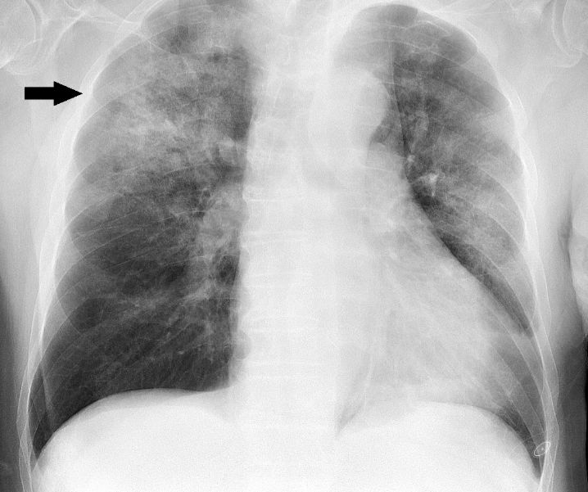
Motivation
Chest X-rays serve as one of the main sources of detection techniques for Pneumonia even to this day.
Doctors primarily recommend for an X-ray scan when person is suffering from symptoms of Pneumonia.
X-ray scans do provide a lot of information about the infection.

Slide 5
It is very important that the X-ray scans are properly processed. The idea is to use the X-ray scans to let machine predict the presence of Pneumonic infection.
It is of very high importance to detect and treat the infection in primary stages to reduce the mortality rates.
As it is the primary reason for infant mortality, it is of very high priority to build an efficient model which can detect the infection, so that the patient starts with the treatment as early as possible.

Slide 6
Wang et al. worked on the same data set with GoogLeNet, VGGNet-16, ResNet, AlexNet and classify 8 different Thorax diseases (among the existing 14 disease labels in the dataset). A small number of images with infection which have hand labeled bounding boxes are used as ground truths for the localization of the infection. The prediction is again a heatmap indicative of the location of one of the 8 thoracic disease. They achieve an AUCROC of 63.33% for Pneumonia.
Yao et al. work on classifying 14 different thoracic diseases using densely connected convolutional neural networks on the same data set used by Wang et al. They achieve an AUCROC score of 71.3%.
Jameson Merkow and team work on 3000 chest X-rays with tightly labeled bounding boxes as part of 2018 RSNA Pneumonia challenge. They employ a CoupleNet, a fully convolutional neural network incorporating global and local features for object detection. They report an IoU average C-score (based on averaging over various thresholds per image) of 0.2310.

Slide 7
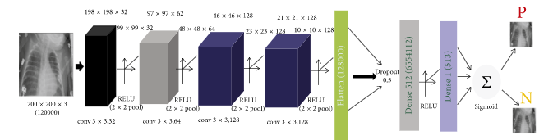
Stephen and team published a paper in Journal of Healthcare Engineering on employing Convolutional Neural Networks to classify to two classes (Pneumonia and non-Pneumonia). This paper is the closest of the other works which we will be employing as the baseline. The dataset employed contains 5856 X-ray images of anterior-posterior chests. They produce a classification accuracy of 93.73% on the validation set and a 95.31% on training set. The dataset used by them is same as employed in our project report.

Slide 8
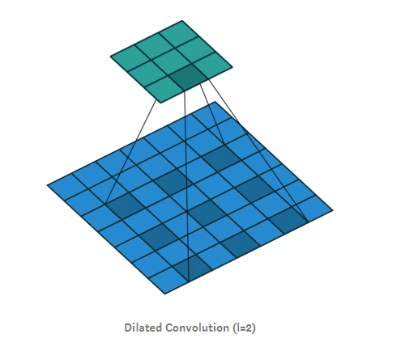
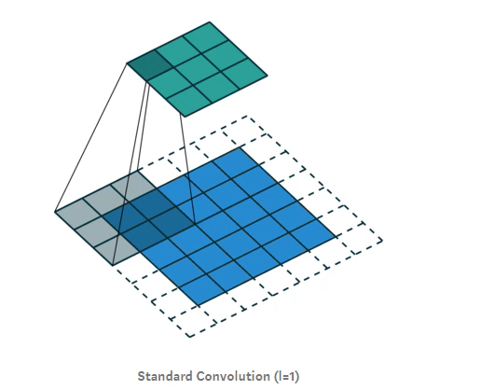
Yu et al. propose multi scale context aggregation by Dilated Convolutions. There has been significant improvement with the usage of the dilated convolutions over the conventional convolutional blocks, which support exponential expansion of the receptive fields without losing resolution.

Slide 9
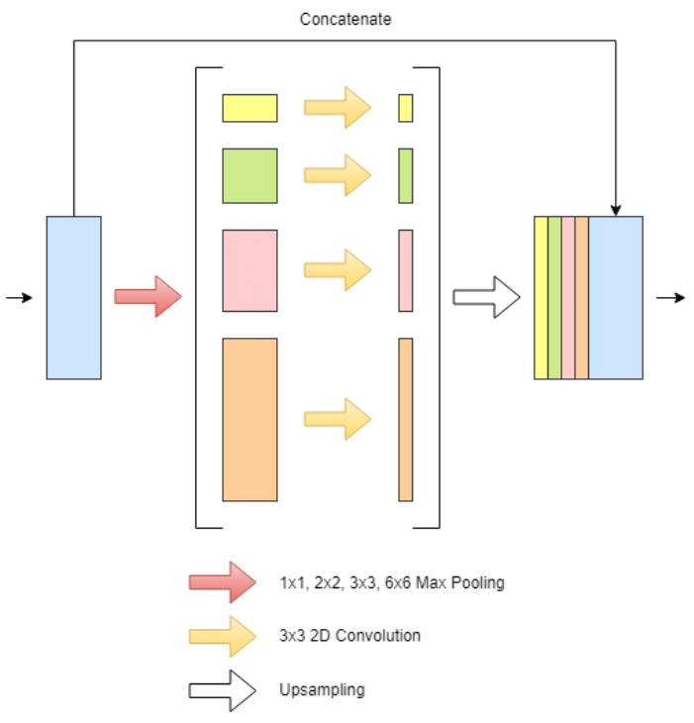
He et al. propose a technique of spatial pyramid pooling on Deep convolutional networks which generates a fixed length representation regardless of the image size/scale. They produce better accuracy with faster running time than R-CNN.

Slide 10
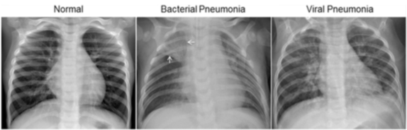
Dataset Description
The Dataset employed in the project consists of Chest X-Ray images with two categories (Pneumonia and non-Pneumonia) and is available on Kaggle. This dataset was updated by Paul Mooney and is available at https://www.kaggle.com/paultimothymooney/chest-xray-pneumonia.
The data set contains Bacterial and Viral tags on the Pneumonia patient scans. The link contains training, validation and test folders each having both positive and negative samples.

Slide 11
The images are in jpeg format and the labels for each image has to be generated based on the separate folders maintained for positive and negative examples mentioned. The images are of 1450 x 1144 resolution with a depth of 8 bits.
Is the dataset sufficient? Does it have enough samples for training?
The same dataset is employed by the authors Stephen et al. for the Journal of Healthcare Engineering.
They have obtained a state-of-the-art result on the data set.
Also, employing data augmentation can significantly improve the size of the dataset. Hence, providing sufficient samples for training.

Slide 12
Proposed methods
As discussed in the related works, the dilated convolutions show a significant improvement over the conventional convolutional blocks.
Also, as discussed in the related works, in the pyramid pooling approach, the same image undergoes different level of pooling and they are later combined efficiently to obtain the same resolution feature maps improve the classification accuracy.
Inspired by the above two ideas, in each layer of convolutional block we propose two modifications:
Instead of conventional convolutional filters, dilated convolutions are employed.
Different level of features is extracted in each layer (using various level of dilated convolutions (3 x 3, 5 x 5, 7 x 7).

Slide 13
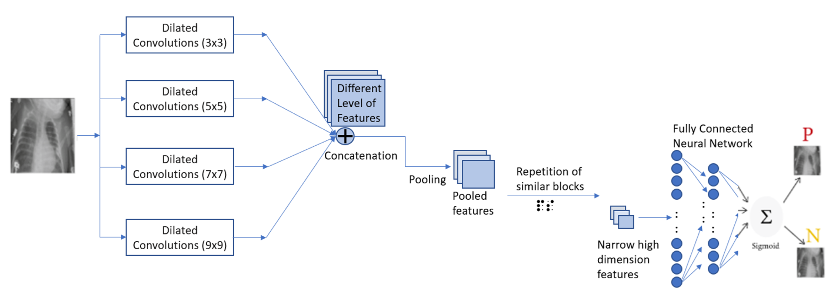
Proposed architecture

Slide 14
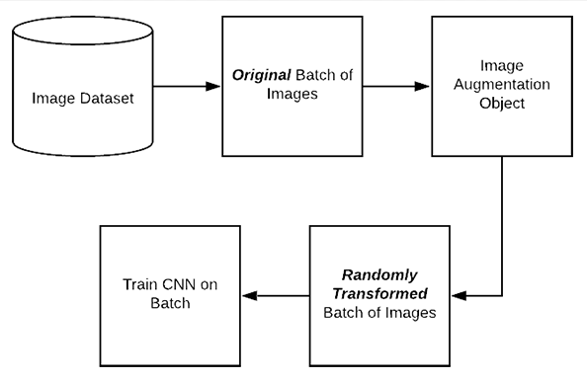
These obtained features are concatenated and the high-dimensional, high-information feature blocks are traversed through a long similar network and finally a fully connected layer is employed to perform classification.
Also, data augmentation techniques will be employed to increase the dataset size and introduce more samples for training.

Slide 15
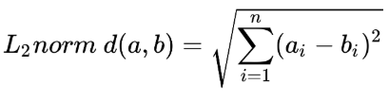
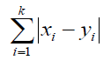
Data Study using KNN
To understand if the training and test data are different is an important part of the study to justify that the Machine Learning model is able to generalize better.
One of the ways to understand how far is the Test data from the Train data is to compute the L2 distance measure (Euclidean distance) between the Test image and the Training images. The L2 distance measure is computed as follows:
Another important distance metric is the L1 distance measure or the Manhattan distance. This distance metric is particularly important for high dimensional data. The L1 distance measure is computed as follows:

Slide 16
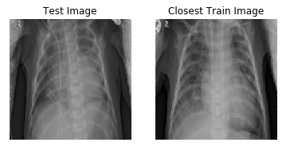
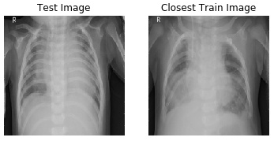
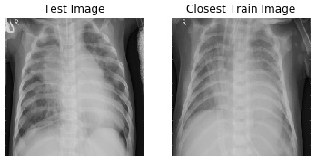
Sample Test-closest Train image pair

Slide 17
RESULTS
Statistical measures | L1 (Manhattan) distance (per pixel) | L2 (Euclidean) distance (per pixel)
MEAN | 20.60 | 0.1528
MEDIAN | 19.93 | 0.1495
STANDARD DEVIATION | 3.855 | 0.034
MINIMUM | 12.06 | 0.095
MAXIMUM | 33.41 | 0.2534
The table presents the results of the statistical study performed on the L1 and L2 distance measure of the Test- closest Train image pair over the entire Test data.

Slide 18
OBSERVATIONS
We observe that on an average, each pixel is at least 20.60 units different from the corresponding pixel intensity of the corresponding closest Training image.
Based on the minimum statistics, we observe that each pixel is 12.06 units different than the corresponding pixel intensity of the corresponding closest Training image.
When we study the distance in the high dimensional space, each pixel is at least 0.1528 units far from the corresponding pixel of the corresponding closest Training image, on an average. Overall, on an average, each Test image is approximately 5812.36 units far from the corresponding closest Train image.

Slide 19
Unsupervised Learning approach: K-Means
Many a times, for binary classification problem, an unsupervised learning approach of K-Means is sufficient to solve the problem.
A K-Means model is employed to understand if the model can classify the data distribution based on the distance between the similar samples.
These models turn out to be very effective in various problems.
The Training data is presented as high dimensional vector of size 40000. A two-class mapping is obtained and two local means of the data is obtained based on the training data. Based on the two classes, training accuracy is obtained.
The same approach is performed on the unseen Validation and Test data. The Validation and Test data is presented and classification is performed based on the obtained mean and the data samples.

Slide 20
OBSERVATION
The K-means model was presented with the high dimensional Training data with two-class constrain.
A similar approach on the Validation and Test data are also performed. The table presents the training and test accuracy of the K-means model.
We observe that the test accuracy of 40.5% is achieved in our implementation. The training accuracy of 52.03% is achieved.
Data set | Accuracy
Train Data set | 52.03%
Validation Data set | 50%
Test Data set | 40.54%

Slide 21
Baseline Implementation without Data Augmentation
The baseline is implemented based on the works of Stephen and team. The baseline model consists of the feature extractor part and Classifier part.
The details of each layer is same as before. The only difference is that the model now sees the augmented data as well as the original data.
The training process is also similar.

Slide 22
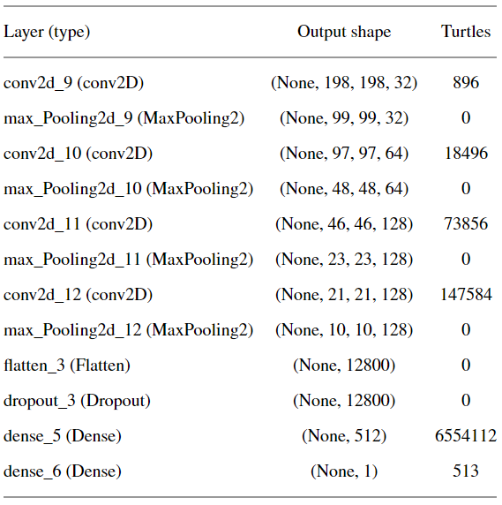
Details of Baseline Model

Slide 23
Observation
The model was trained with a learning rate of 0.0001 and binary cross entropy loss function. Adam optimizer was employed and training was performed for 50 epochs on NVIDIA RTX 2060 GPU.
We observe that the test accuracy mentioned in the paper is not reached in our implementation. The training accuracy, as quoted in the journal is reached. We observe a training accuracy of 96.35%.
However, the best test accuracy of our baseline model implementation is 84%, while the test accuracy quoted in the journal is 93%.
From Filter Visualization, we can observe higher and higher level features extracted as we go deeper.
From TSNE Visualization, we can observe how the model starts classifying better after each layer.
Data set | Accuracy
Train Data set | 96.35%
Test Data set | 84.00%

Slide 24
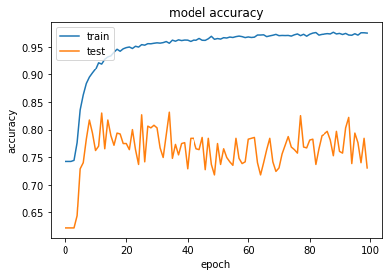
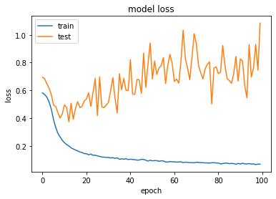
RESULTS

Slide 25
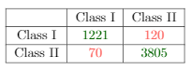
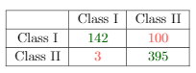
Confusion Matrices
Train Confusion Matrix
Test Confusion Matrix

Slide 26
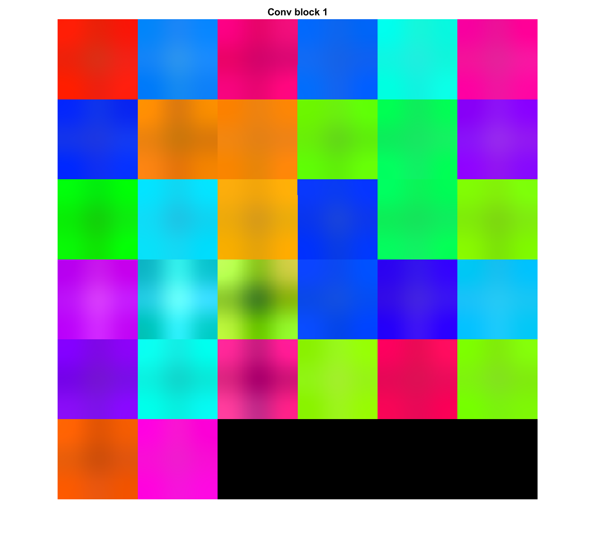
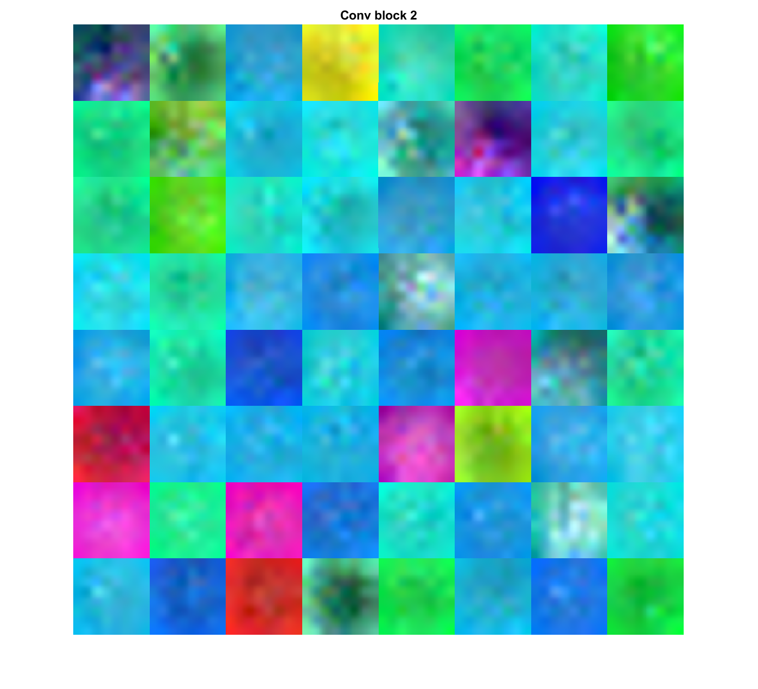
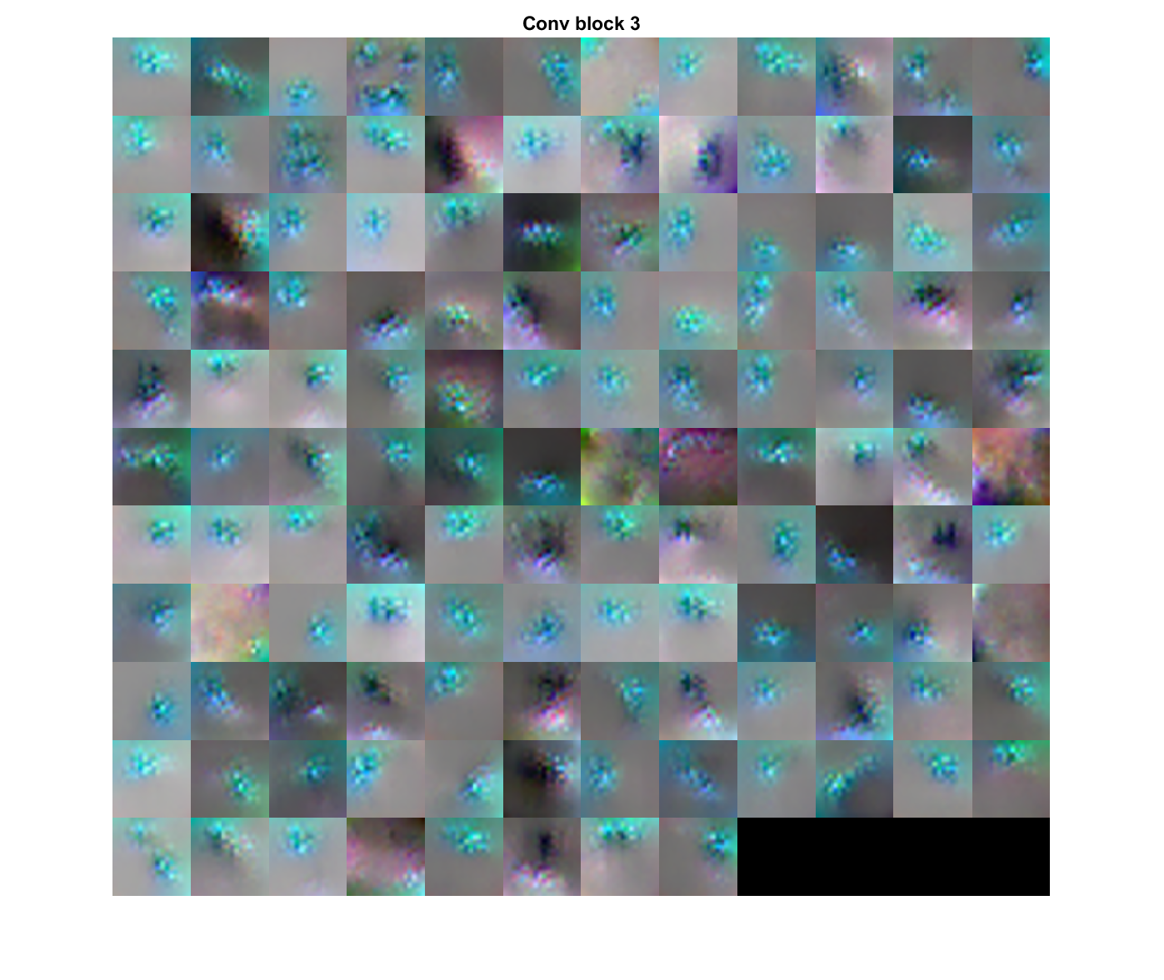
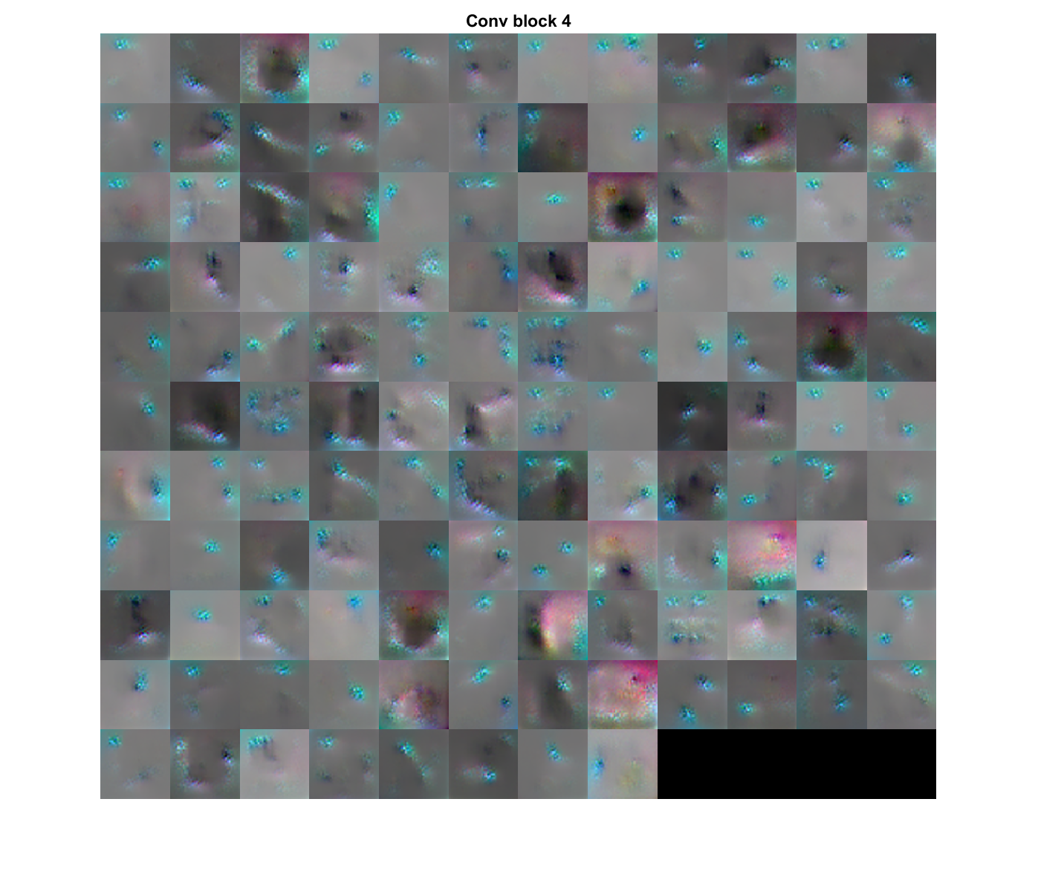
Filter Visualization
Conv1 Block
Conv2 Block
Conv3 Block
Conv4 Block

Slide 27
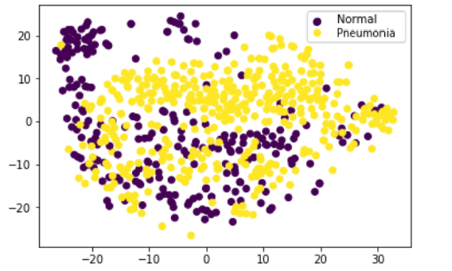
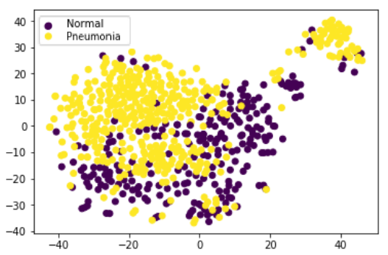
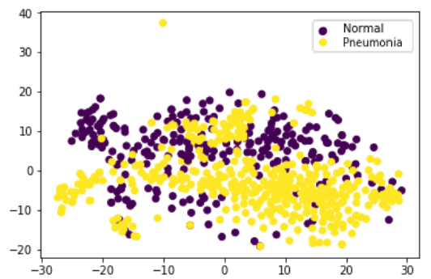
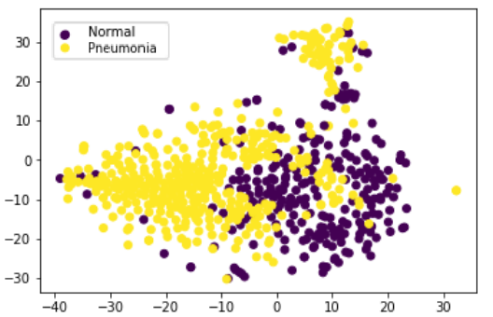
TSNE Visualization
Conv1 Block
Conv3 Block
Conv2 Block
Conv4 Block

Slide 28
Data Augmentation based on the Baseline
Data augmentation is implemented to artificially increase the size and quality of the dataset.
The process helps in overcoming the problem of overfitting.
Data Augmentation is performed based on the works of the Baseline.
We observed from the Results of the Baseline model without data augmentation, the test accuracy reached a peak of 84\% and dropped on further training.
The augmentation is performed in terms of Rescale, Rotation, Shift, Zoom and Horizontal flips.
We perform data augmentation such that the previously unequally distributed NORMAL and PNEUMONIA cases are now approximately equal to 10000 images each.

Slide 29
The details of the augmentation performed by the authors of the baseline journal and in the course of the project to realize Baseline with augmentation is presented in the table.
Overall, there are approximately 40000 samples including the original samples.
Hence, this is approximately 4-fold increase.
With this operation there are sufficient samples to perform further experiments.
Augmentation method | Augmentation Value
Rescale | 1/255
Rotation Range | 40
Shear Range | 0.2
Zoom Range | 0.2
Width Shift | 0.2
Height Shift | 0.2
Horizontal Flip | TRUE

Slide 30
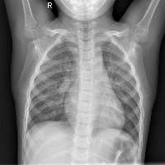
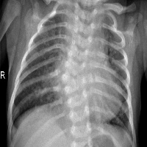
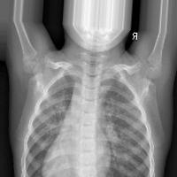
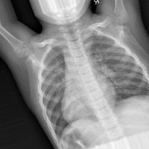
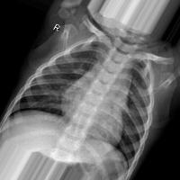
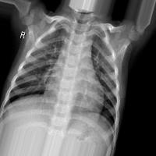
Sample Augmentations
Normal
Pneumonia

Slide 31
Baseline Implementation with Data Augmentation
The baseline is implemented based on the works of Stephen and team. The baseline model consists of the feature extractor part and Classifier part.

Slide 32
Observation
The model was trained with a learning rate of 0.0001 and binary cross entropy loss function. Adam optimizer was employed and training was performed for 50 epochs on NVIDIA RTX 2060 GPU.
The model reaches a training accuracy of 96.92%, however, a test accuracy of 87.63%.
The performance has still not reached as quoted in the Baseline.
From Filter Visualization, we can observe higher and higher level features extracted as we go deeper.
From TSNE Visualization, we can observe how the model starts classifying better after each layer.
Data set | Accuracy
Train Data set | 96.92%
Test Data set | 87.63%

Slide 33
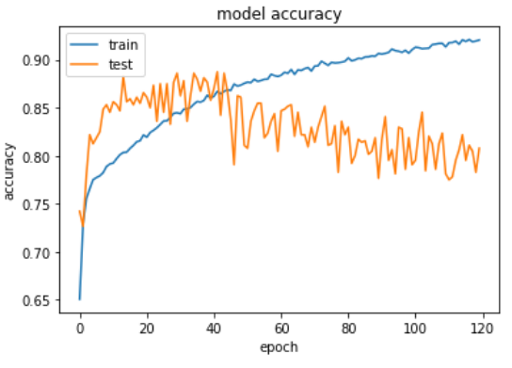
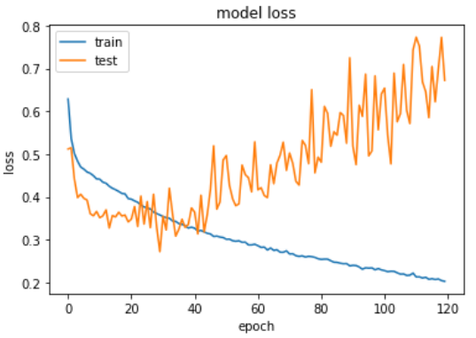
RESULTS

Slide 34
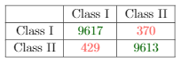
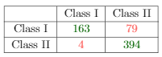
Confusion Matrices
Train Confusion Matrix
Test Confusion Matrix

Slide 35
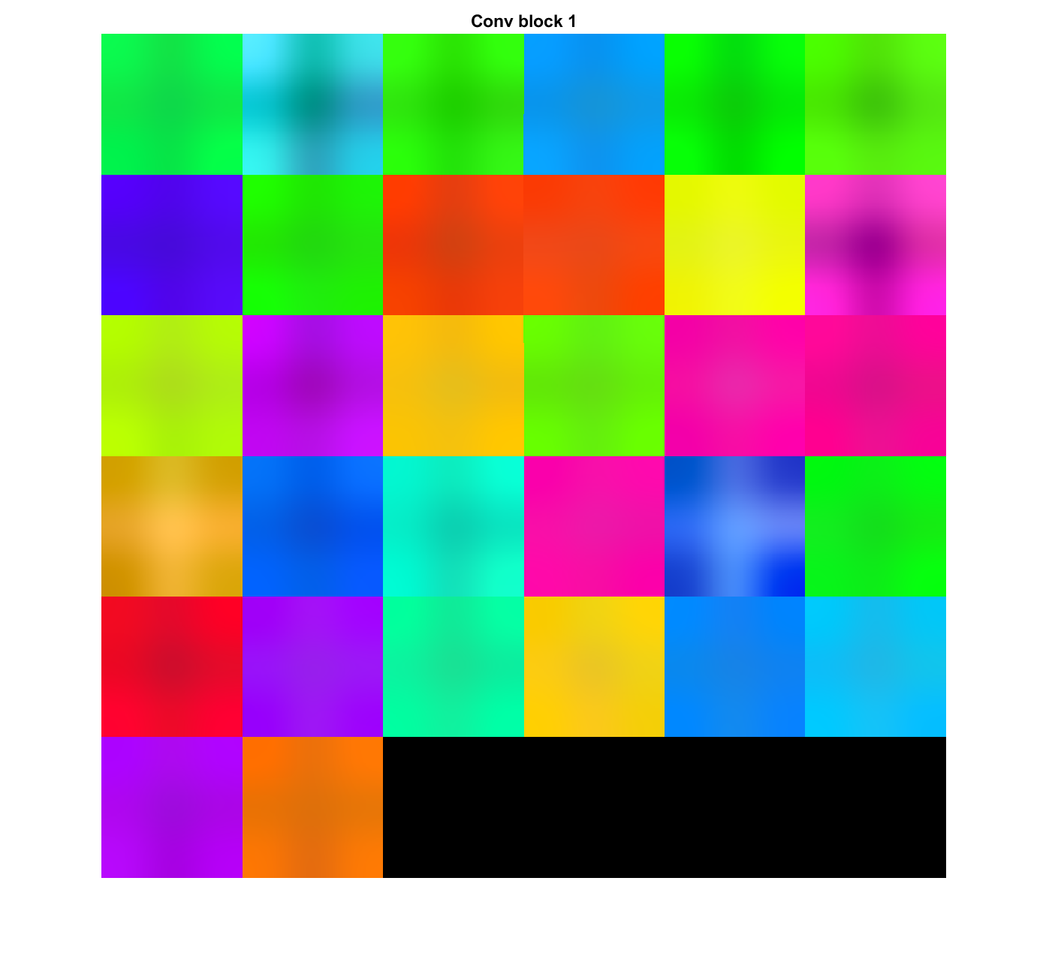
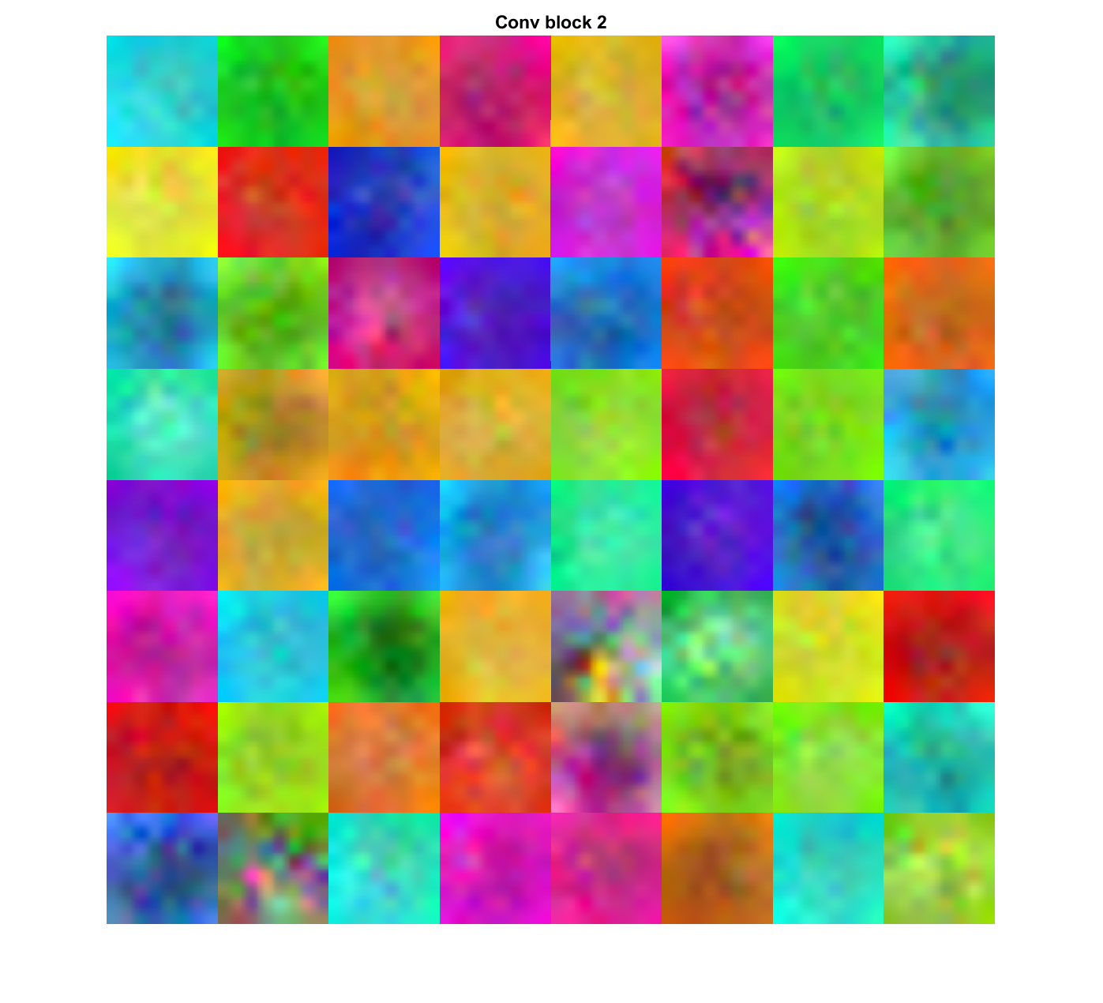
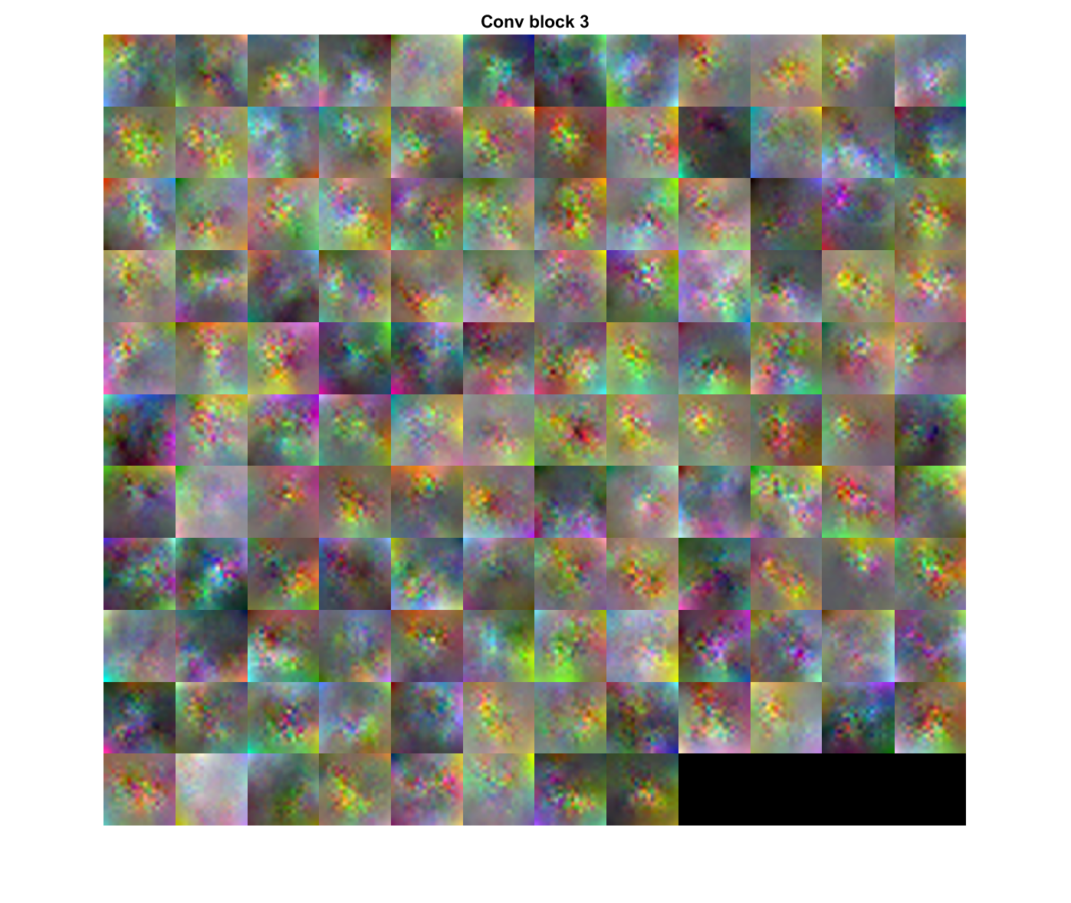
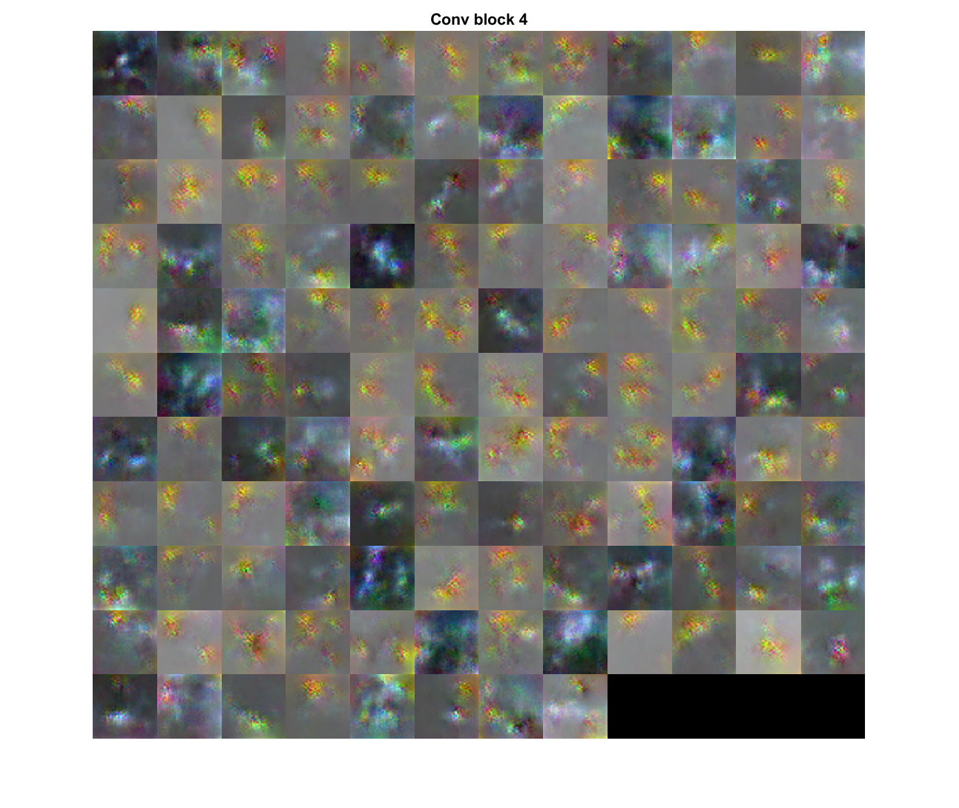
Filter Visualization
Conv1 Block
Conv2 Block
Conv3 Block
Conv4 Block

Slide 36
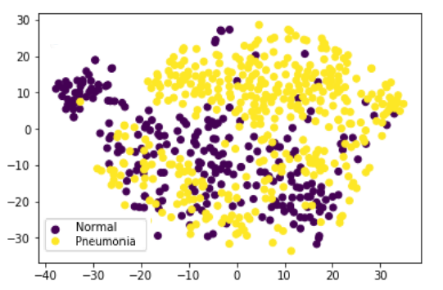
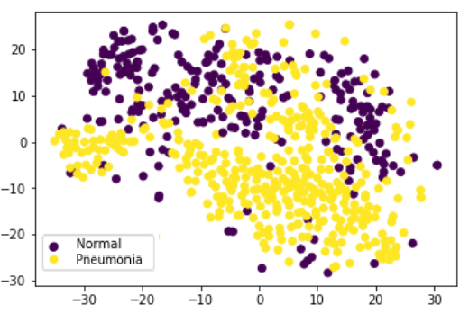
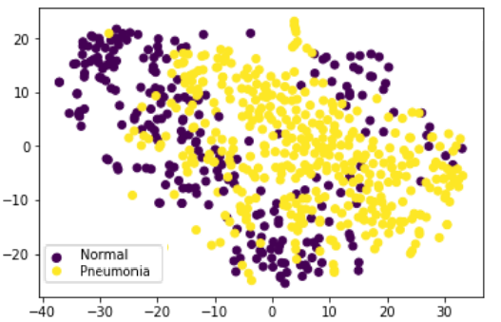
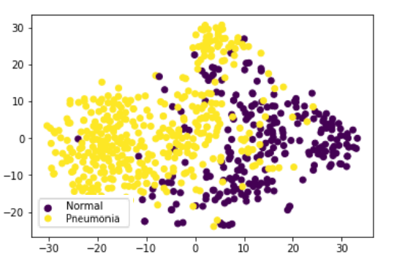
TSNE Visualization
Conv1 Block
Conv3 Block
Conv2 Block
Conv4 Block

Slide 37
Proposed architecture

Slide 38
X-Net Implementation
The X-Net is implemented taking inspiration from the works of Yu et al. on Dilated Convolutions and works of He et al. on Spatial Pyramid Pooling.
The details of each layer is explained in the table and the model is trained on the augmented data as well as the original data.
The model has multiple blocks extracting the different level of features that are finally used for classification.

Slide 39
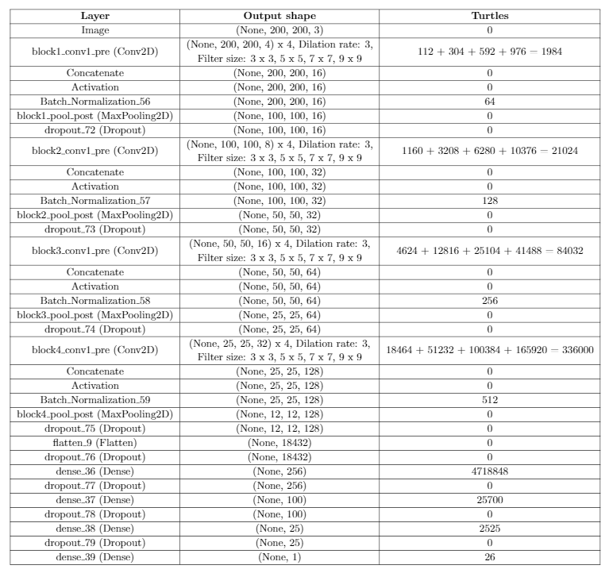
Details of X-Net Model

Slide 40
Observation
The model was trained with a learning rate of 0.0001 and binary cross entropy loss function. Adam optimizer was employed and training was performed for 100 epochs, with batch size of 20 on NVIDIA RTX 2060 GPU.
We observe that a test accuracy of 89.9% was achieved.
On further training for 20 more epochs, a training accuracy of 94.15%
We observe a slight improvement over the baseline model.
Data set | Accuracy
Train Data set | 94.15%
Test Data set | 89.9%

Slide 41
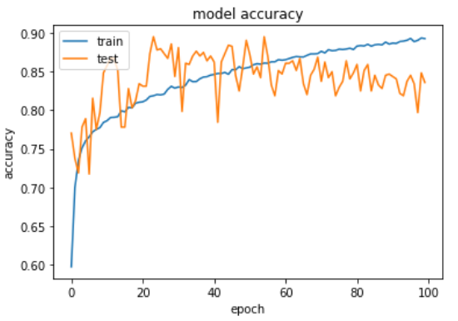
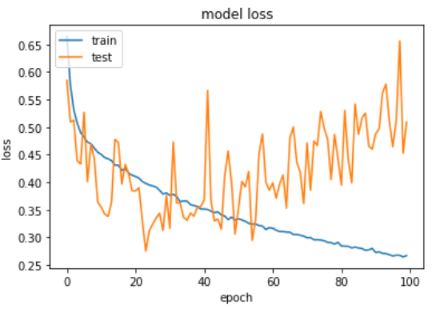
X-Net RESULTS

Slide 42
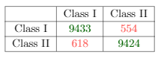
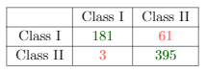
Confusion Matrices
Train Confusion Matrix
Test Confusion Matrix

Slide 43
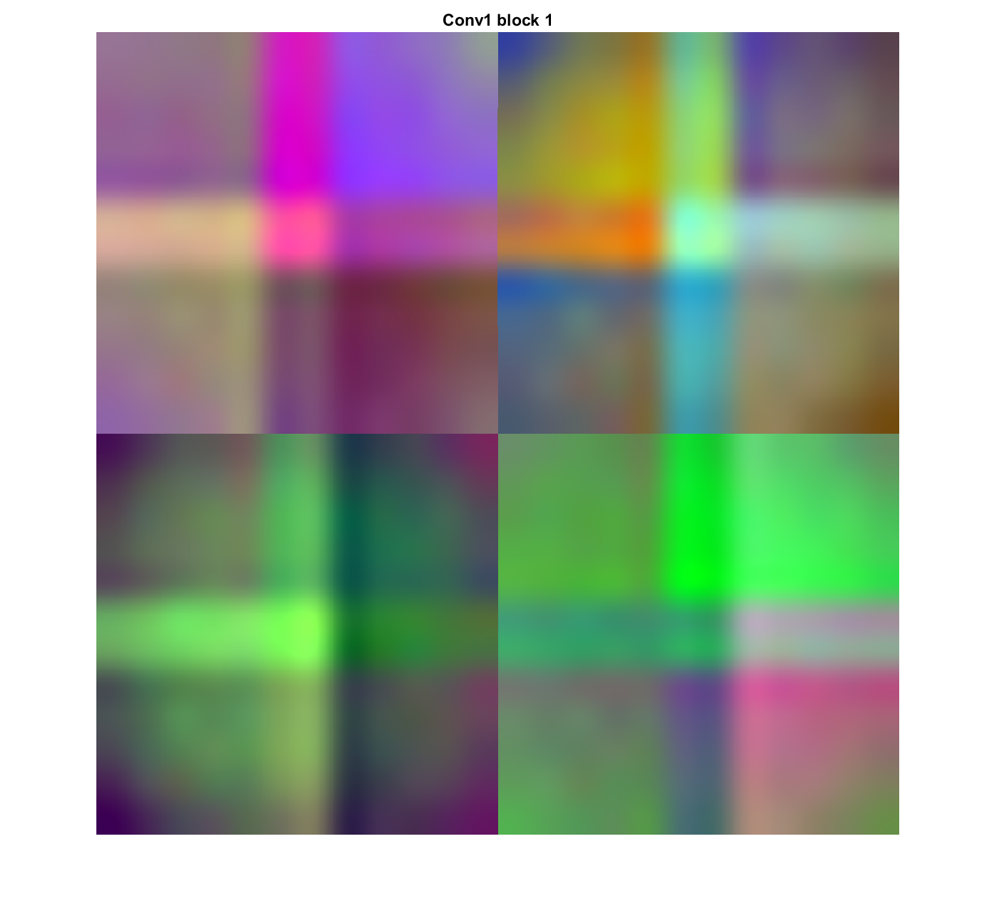















X-Net Filter Visualization
Conv1 Block
Conv2 Block
Conv3 Block
Conv4 Block

Slide 44




TSNE Visualization
Conv1 Block
Conv3 Block
Conv2 Block
Conv4 Block

Slide 45
Inference
From Filter Visualization, we can observe higher and higher level features extracted as we go deeper.
From TSNE Visualization, we can observe how the model starts classifying better after each layer.
We observe the improvement due to much higher level of feature extraction.
There needs to be more finetuning needed (out of scope of this Term Project as it requires a lot more time) and there could be further improvement.

Slide 46
ISSUES FACED
We observe that the model does not achieve a very good performance as quoted in the baseline.
Due to the large data samples of augmentation, training takes more time and hence, finetuning takes more time.

Slide 47
FUTURE WORKS
Work on further finetuning.
Including Semi-Supervised learning along with the proposed architecture.
Including Squeeze-Excitation block and experimenting to check for improvement.

Slide 48
References
Citation of data: Kermany, Daniel; Zhang, Kang; Goldbaum, Michael (2018), “Large Dataset of Labeled Optical Coherence Tomography (OCT) and Chest X-Ray Images”, Mendeley Data, v3 http://dx.doi.org/10.17632/rscbjbr9sj.3
Pneumonia Detection in Chest Radiographs: The DeepRadiology Team
Pranav Rajpurkar, Andrew Y. Ng et al., “CheXNet: Radiologist-Level Pneumonia Detection on Chest X-Rays with Deep Learning”.
Wang et al., “ChestX-ray8: Hospital-scale Chest X-ray Database and Benchmarks on Weakly-Supervised Classification and Localization of Common Thorax Diseases”.

Slide 49
Yao et al., “LEARNING TO DIAGNOSE FROM SCRATCH BY EXPLOITING DEPENDENCIES AMONG LABELS”.
Stephen et al., “An Efficient Deep Learning Approach to Pneumonia Classification in Healthcare”.
He et al., “Spatial Pyramid Pooling in Deep Convolutional Networks for Visual Recognition”.
Yu et al., “Multi-Scale Context Aggregation by Dilated Convolutions”.
https://towardsdatascience.com/review-dilated-convolution-semantic-segmentation-9d5a5bd768f5
https://www.researchgate.net/figure/An-illustration-of-the-Pyramid-Pooling-Module-PPM_fig2_330700867
https://www.who.int/

